Slide 1
Analysis of Bageshwar district household data
Priyanka Kalmane

Slide 2
Executive summary
1

Slide 3
What to expect from this project?
3 Clusters formed : Developing, Middle level and the developed group
Missing annual average income predicted using Linear regression values
Presentation for seeking philanthropic organization’s interest in the matter of cleanliness in Bageshwar district, Uttarakhand

Slide 4
Dataset information
2

Slide 5
Data description
Survey data conducted by Swaniti in Bageshwar district, Uttarakhand
912 records, each row associated to a household
50 attributes related to agriculture, finance, sanitation
18 quantitative variables, 22 qualitative variables

Slide 6
Exploratory Data analysis
3

Slide 7
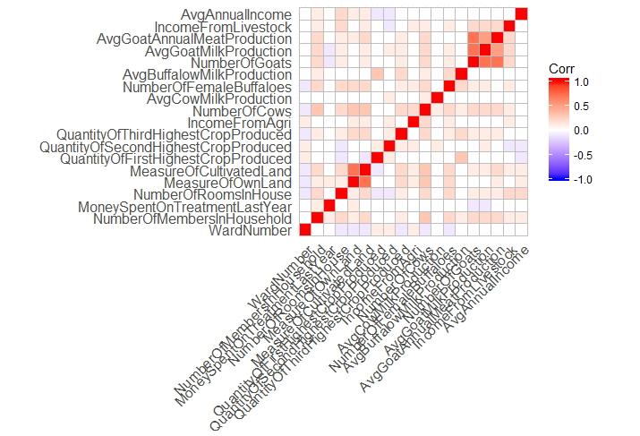
Digging into the data – Steps carried out
Correlation matrix
Summary statistics
Normality tests
Outlier detection
and rejection
Box plots, QQ plots
Data understanding
after outlier removal
Cleaning &
Standardizations

Slide 8
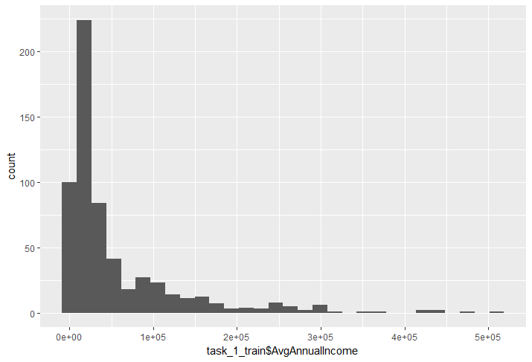
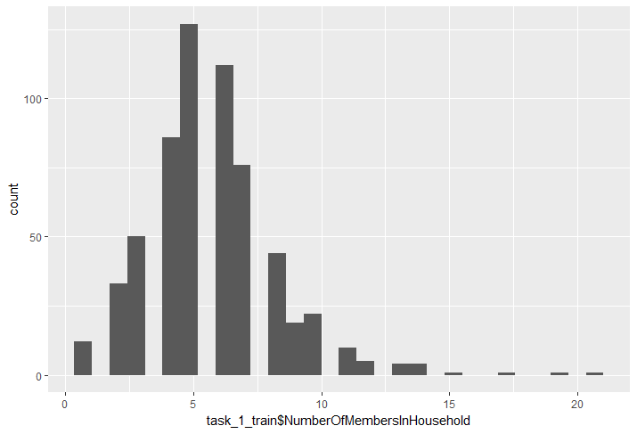
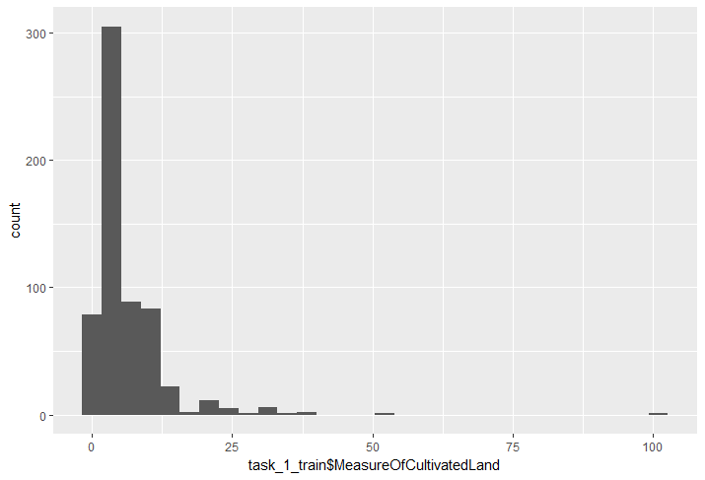
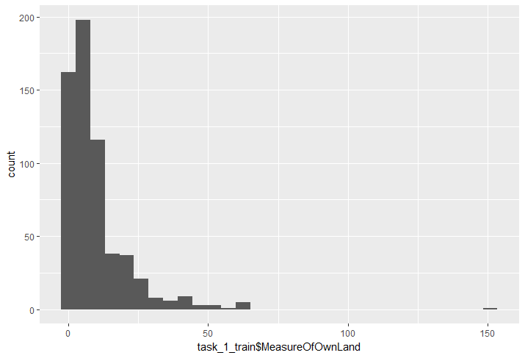

Slide 9
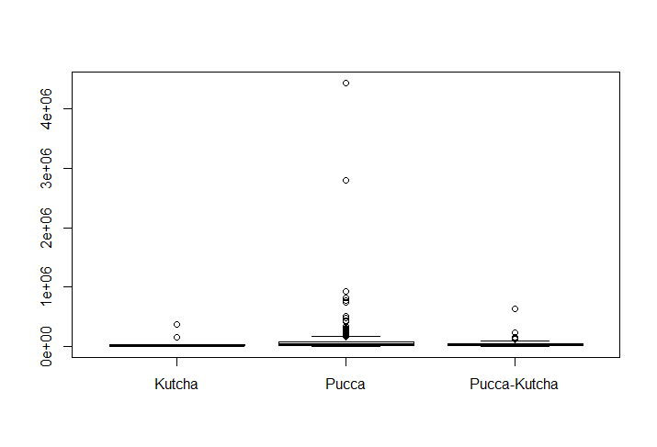
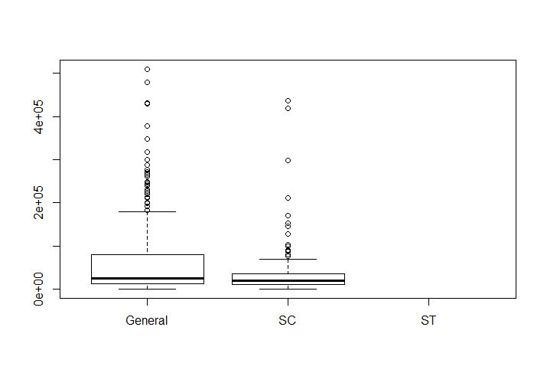
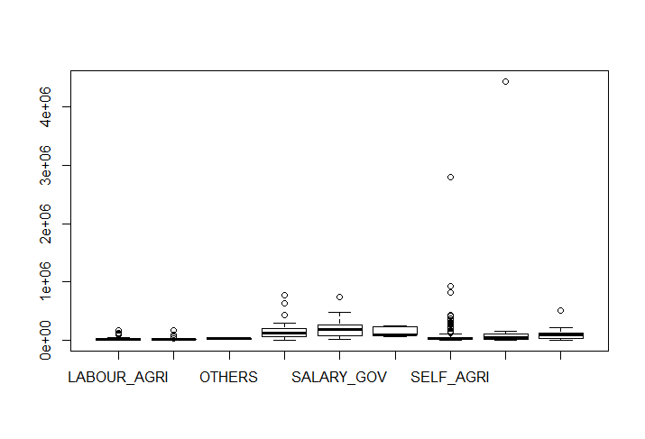
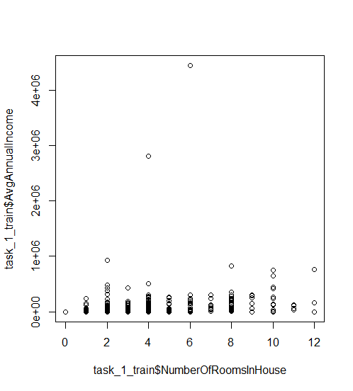
Caste vs Annual Income
House type vs Annual Income
Occupation vs Annual Income
Number of rooms vs Annual Income

Slide 10
Cleaning
Standardizing measurement data, quantity of crops using the same units
Converting qualitative variables into factors
Converting negative measurement values into “0” to be able to apply transformations

Slide 11
Problem statement & Hypothesis
4

Slide 12
Understanding the problem
To find the segments based on the economic profile.
To find the values of the missing average annual income
To create a pitch for investment for philanthropic organizations
Hypothesis: “Number of rooms, Number of members in the household, measure of lands and the quantity of crops produced have a significant impact on the income”

Slide 13
Methodology
5
Steps followed for Cluster Analysis and Regression

Slide 14
Hierarchical clustering
Mixed data – Techniques other than K-means need to be used
Calculation of “Gower” distance instead of Euclidean distance.
Experiment using “daisy” function from “cluster” package in R
Use of “FactoMineR” package for PCA
Creating the clusters using hierarchical clustering
Considered 596 rows for cluster analysis (The other rows have null values in Avg Income)

Slide 15
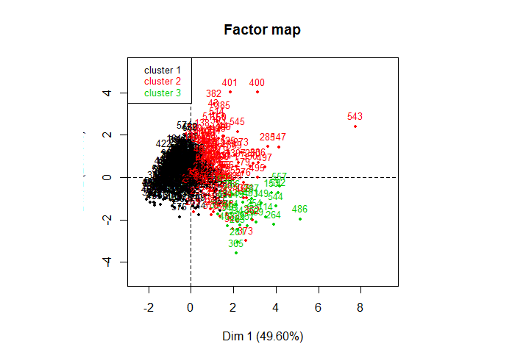
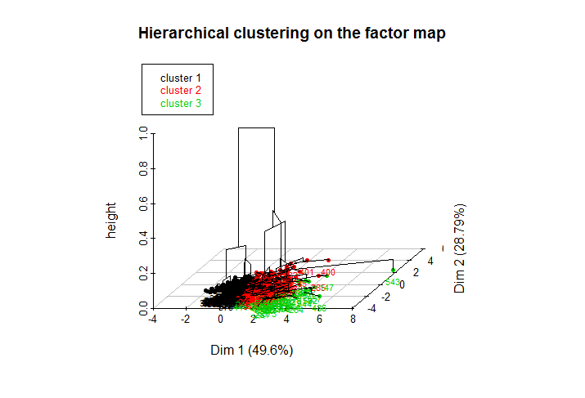
Clusters along the component analysis
3 Clusters using Hierarchical clustering technique

Slide 16
Findings
6
Three clusters and their characteristics

Slide 17
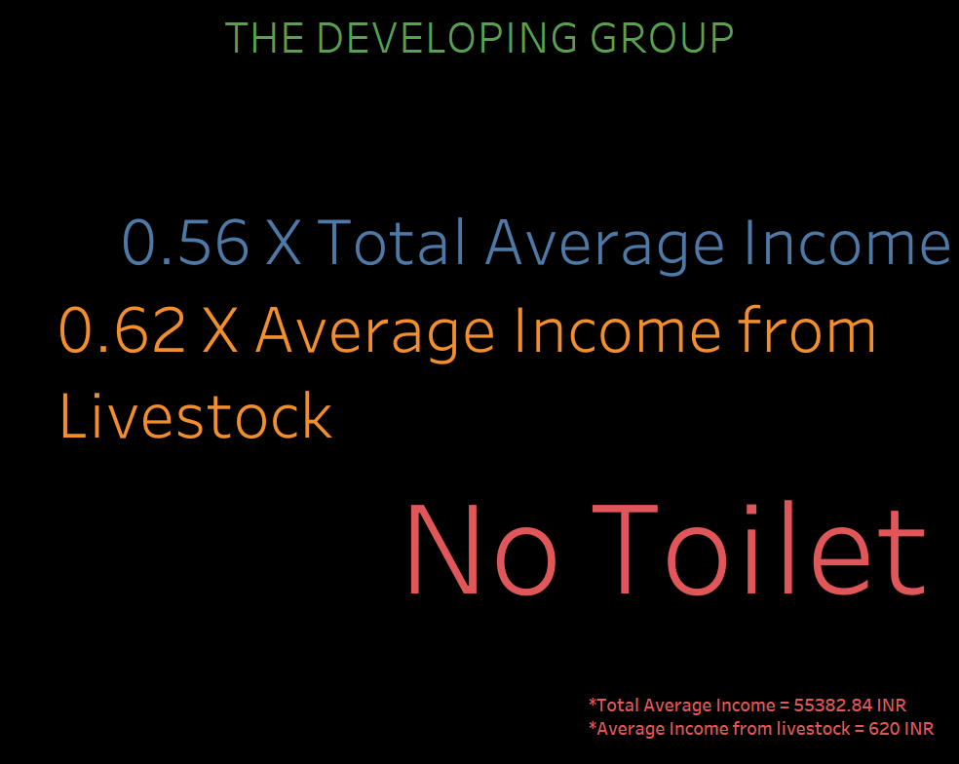

Slide 18
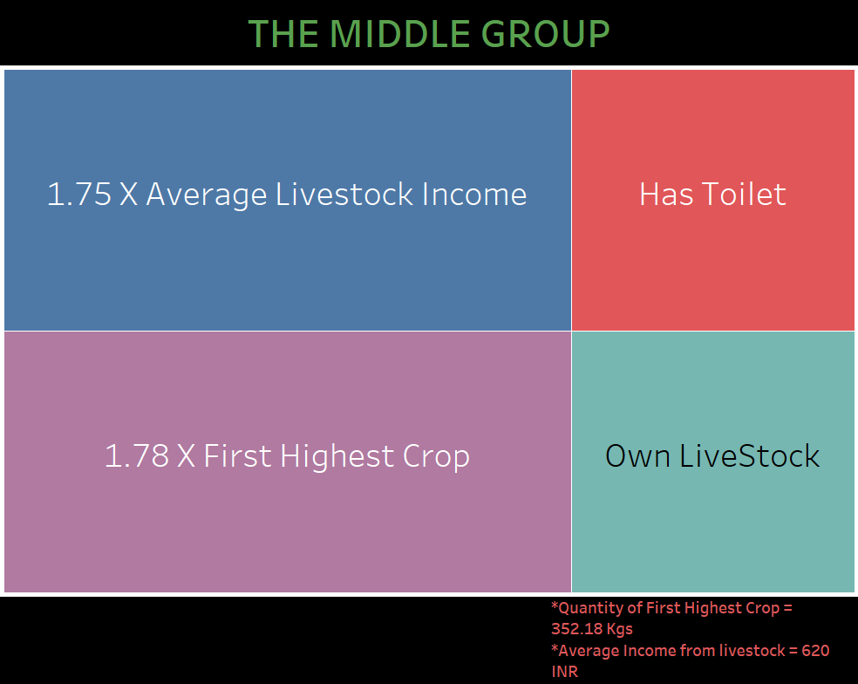

Slide 19
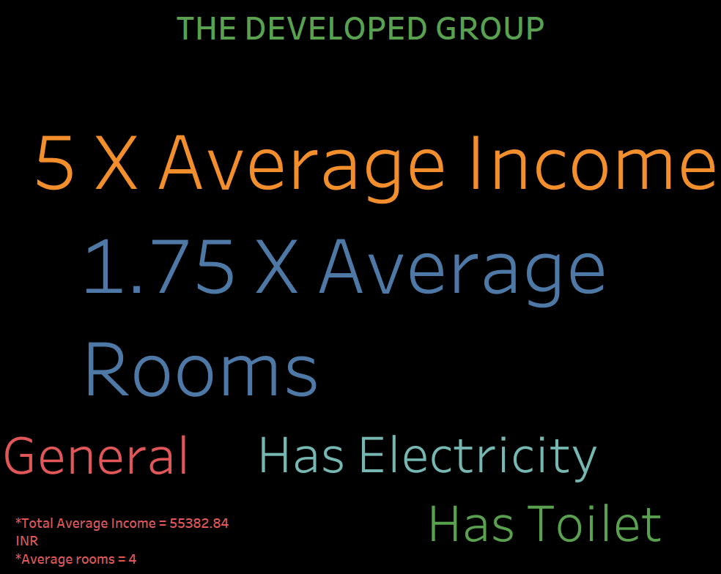

Slide 20
Linear regression
Divided into train and test data sets
Used linear regression model and random forest regression in R
Analysis showed that it is possible to achieve higher R squared value of up to 0.8826 through transformations.
Findings: Overfitting the training data
This was observed when the annual income values were negative or too low, thus meaningless.
Thus, meaningful outcome is achieved by bias-variance trade off. Thus, R squared value of 0.4311 provides better AIC and better results.

Slide 21
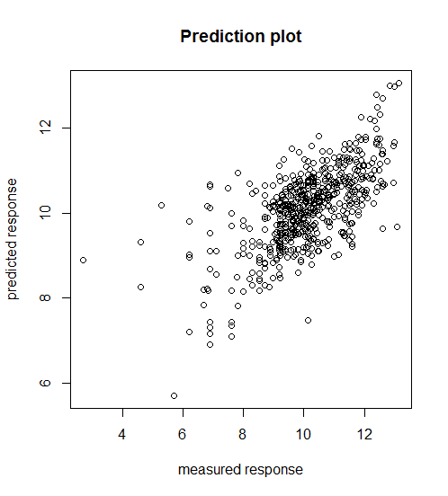
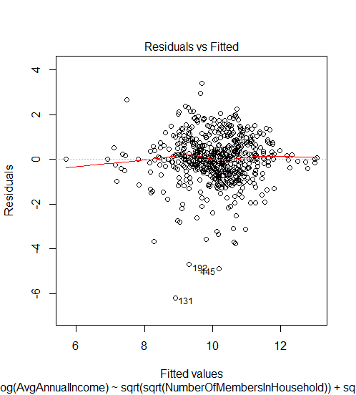
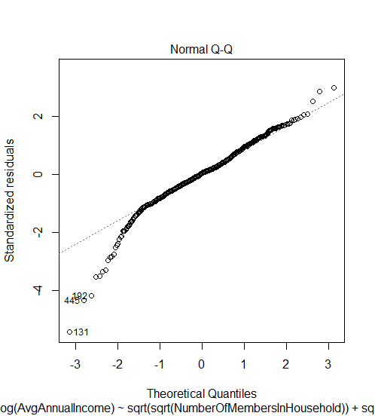

Slide 22
Analysis for the Philanthropic Organizations
Analysis carried out regarding cleanliness in the area.
Preparation of presentation using visualizations created in Tableau

Slide 23
What could be done better?
7
Fine tuning and building better models

Slide 24
Performance boosting
Fine tuning the random forest regression model
The mean of the annual average income post prediction was found to be extremely high, which goes against intuition – Bias variance tradeoff very high
Outliers detected in the values predicted
Thus, more household data needs to be collected in order to build better model
Cluster analysis post prediction of annual average income

Slide 25
Conclusion
8
Take-aways and learning

Slide 26
Learnings from this exercise
Hypothesis found to be true
Additional variables such as “Has Toilet”, “Has Electricity” found to have an impact as well.
The 3 clusters create using the models follow intuition
Transformations in linear regression leading to better R squared model may not always result in a good model.
To be careful about overfitting the training dataset
Learning to deal with bias-variance trade off.

Slide 27
Thank you

